Slide 1

Credit Card Fraud Detection System
Leveraging Technology to Safeguard Transactions
Anjali Dharmik

Slide 2






Project Team
Security Team
Finance Team
Data Engineer Team
Data Analyst Team
Data Science Team
DevOps Team

Slide 3

Background
What is Credit Card Fraudulent Activity?
Fraudulent activities are defined as any transactions not initiated or authorized by the cardholder.
Stolen credit card or card details.
Customers will be charged for items that they did not purchase.
Why do we require Credit Card Fraud Detection System?
Financial Loss

Slide 4
Victim of Credit Card Fraud in UK

Slide 5
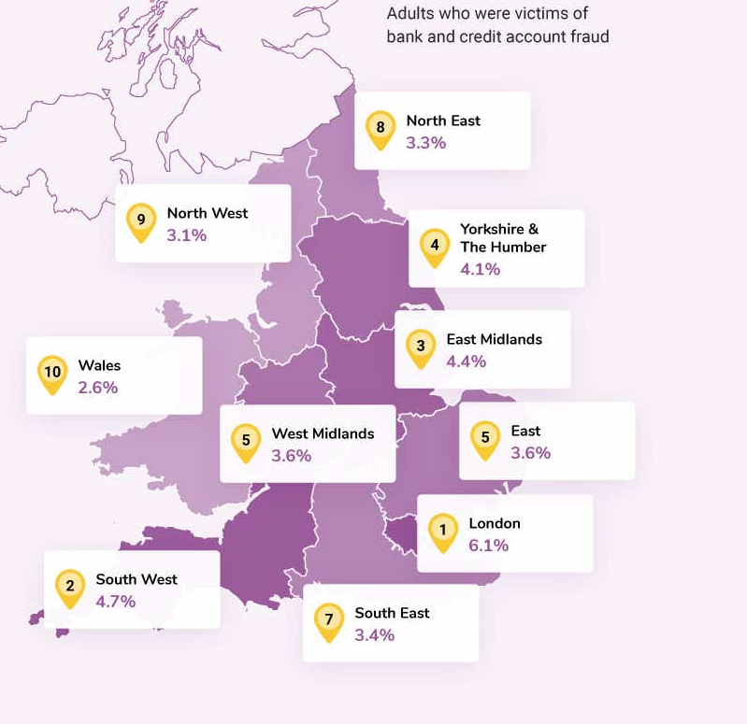
Where does people experience the most credit card fraud?

Slide 6


Traditional Fraud Detection Methods
Rule-Based Systems
Manual Review Processes

Slide 7






Challenges in Credit Card Fraud Detection
Sophisticated Fraud Techniques
Imbalanced Data
Real-Time Processing
Adaptive Fraud Patterns
Regulatory Compliance
Customer Experience

Slide 8






Solution
Accuracy
Real-time Detection
Scalability
Efficiency
Adaptability
Cost-effectiveness

Slide 9
Machine Learning Approach
Google Drive
Load Data
Data Preprocessing
Model Building
EDA
Handle Missing Records
Handle Data Inconsistency
Feature Selection
Data Visualization
Feature Engineering
Data Encoding
Handle Outliers
Data Split
Handle Imbalanced Data
Data Standardization
Hyper Parameter Tunning
Model Selection
Streaming Data
Model Deployment
Model Evaluation
Predicted Data (Fraud/Not Fraud)

Slide 10
Demo

Slide 11

Results
Cost Reduction
Customer Satisfaction
Fewer customers claims
Safer online card transaction platform

Slide 12

Question?

Slide 13

Thank You

